Slide 1
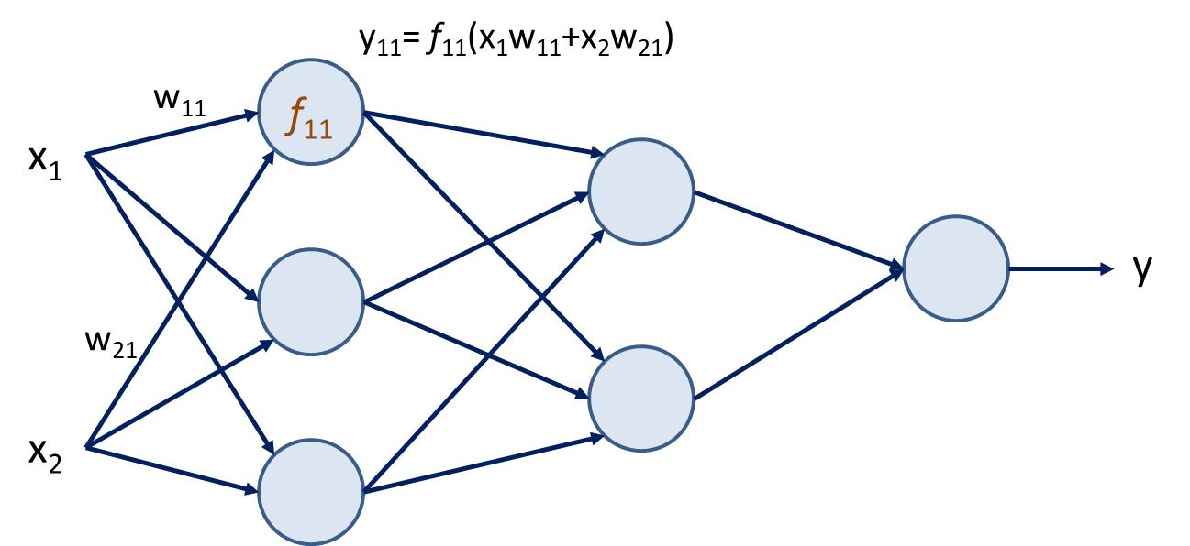
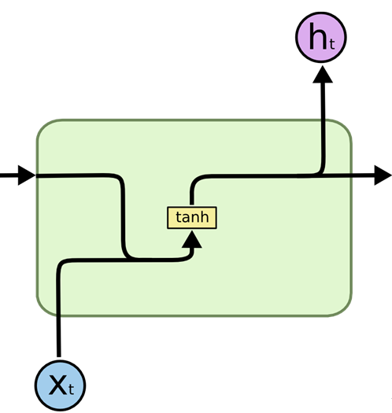

Slide 2
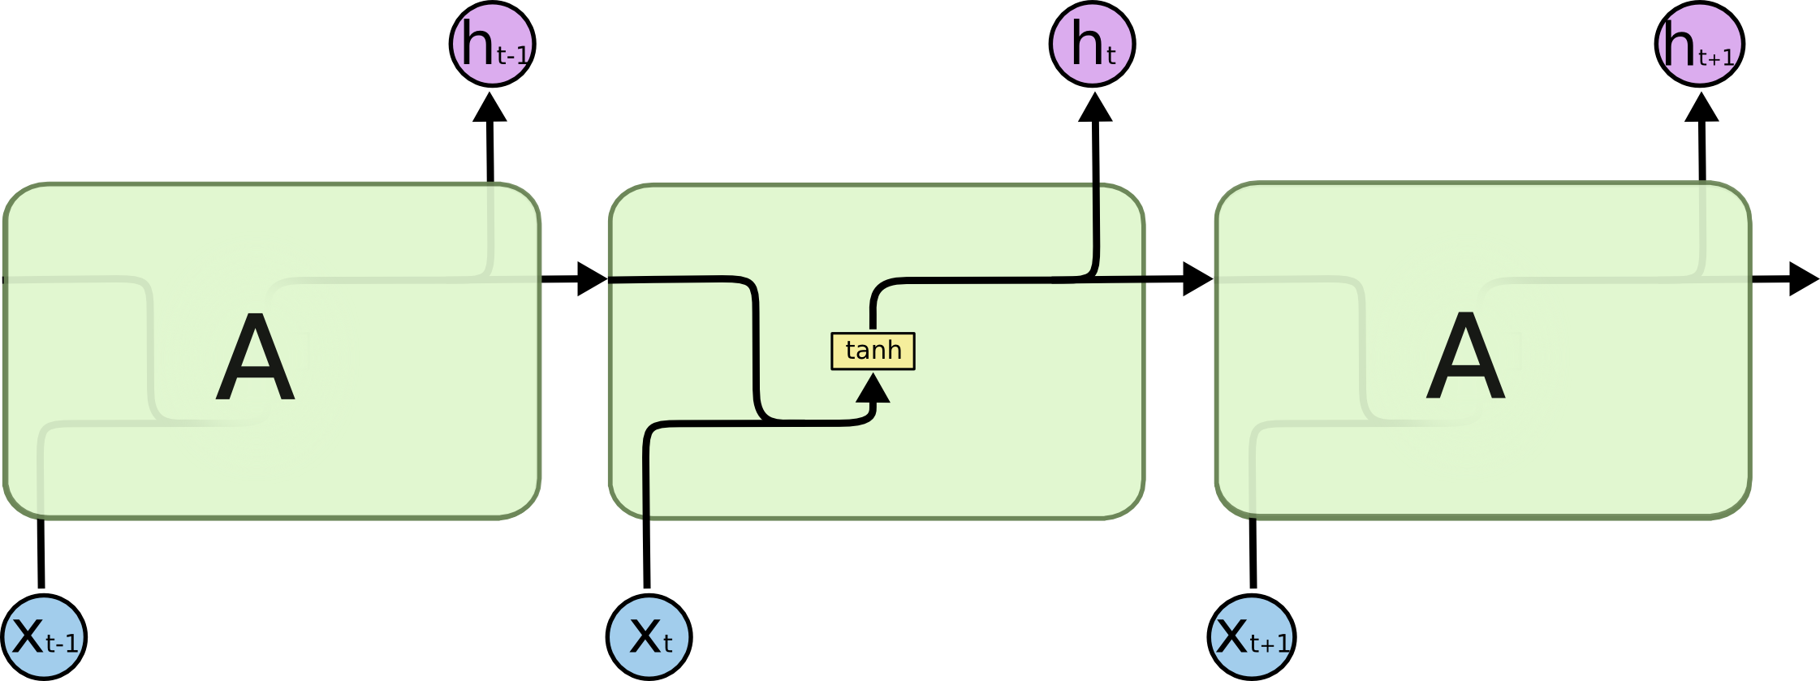
Recurrent neural network
RNN cell visualization for three different time steps t-1, t and t+1. Reference (Olah, 2015)

Slide 3
Long Short-Term Memory (LSTM)
$$h_{t}$$
$$C_{t−1}$$
$$C_{t}$$
x
+
tanh
x
x
$$f_{t}$$
$$i_{t}$$
$$o_{t}$$
$${\tilde{C}}_{t}$$
σ
σ
tanh
σ
$$h_{t−1}$$
$$h_{t}$$
$$x_{t}$$

